Slide 1
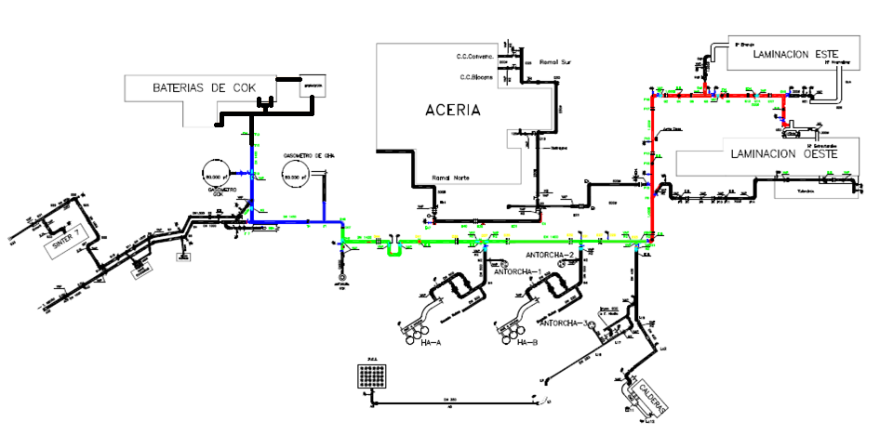
New COG Distribution Layout - Factory of Veriña
Sector I
Sector III
Sector II
Sector I: Rolling Area
Sector II: BFs Area
Sector III: Gasholders Area
Pressure: 620 mm.c.a.

Slide 2
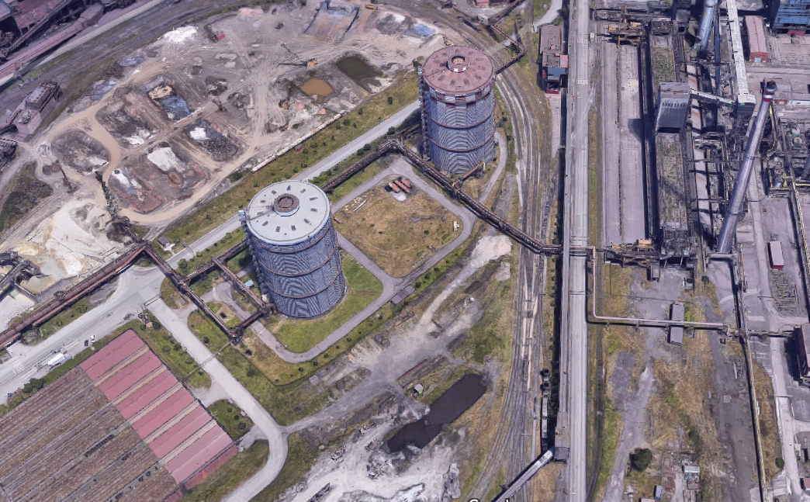
COG Distribution Layout - Factory of Veriña – Sector III
ND 1400; 560 m

Slide 3
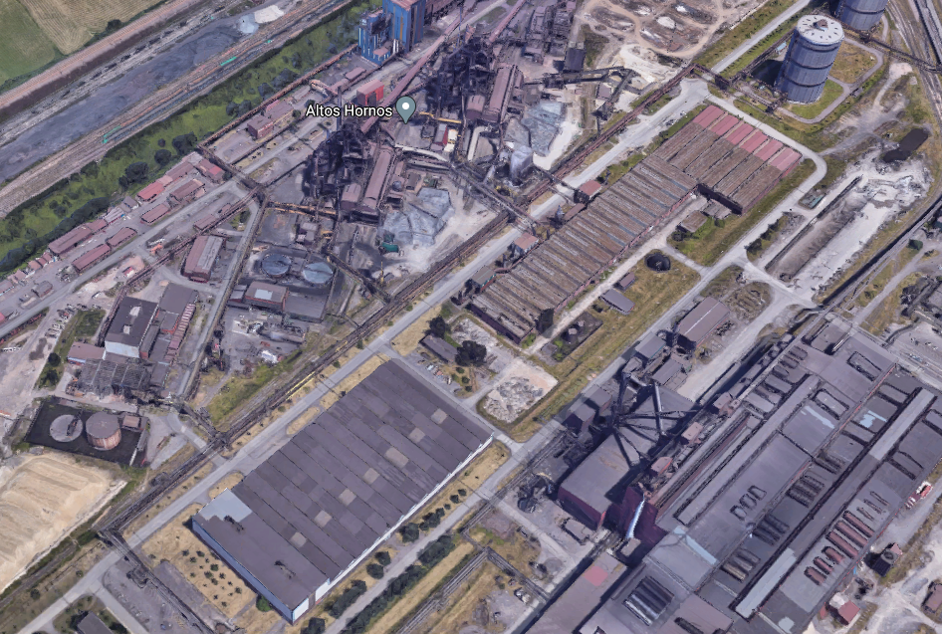
COG Distribution Layout - Factory of Veriña – Sector II
ND 1400; 750 m

Slide 4
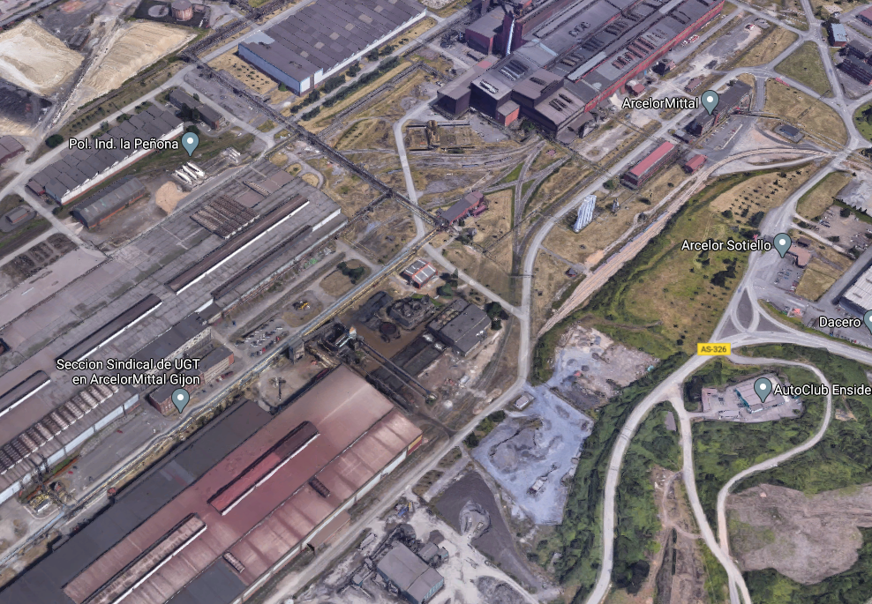
COG Distribution Layout - Factory of Veriña – Sector I
ND 1400; 210 m
ND 1200; 380 m
ND 800; 40 m
ND 700; 240 m

